Slide 1
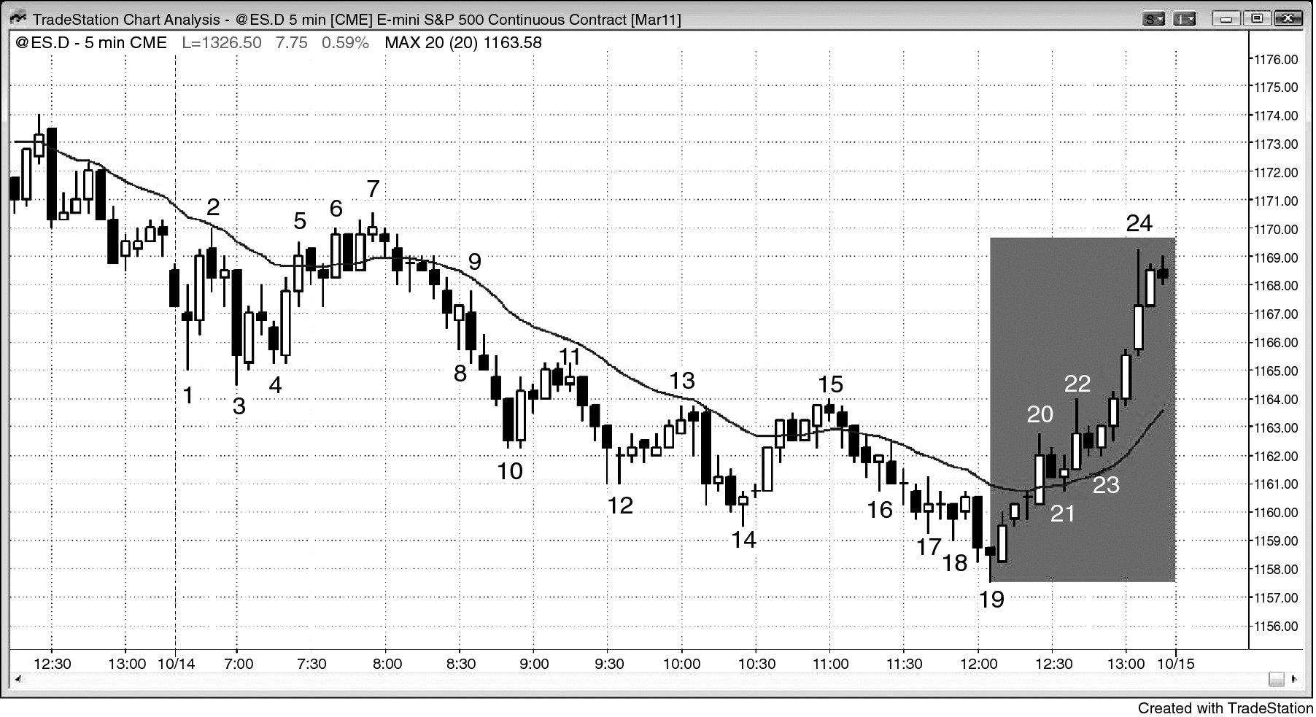
FIGURE 11.1 Risk Managers Contribute to Trends into the Close

Slide 2
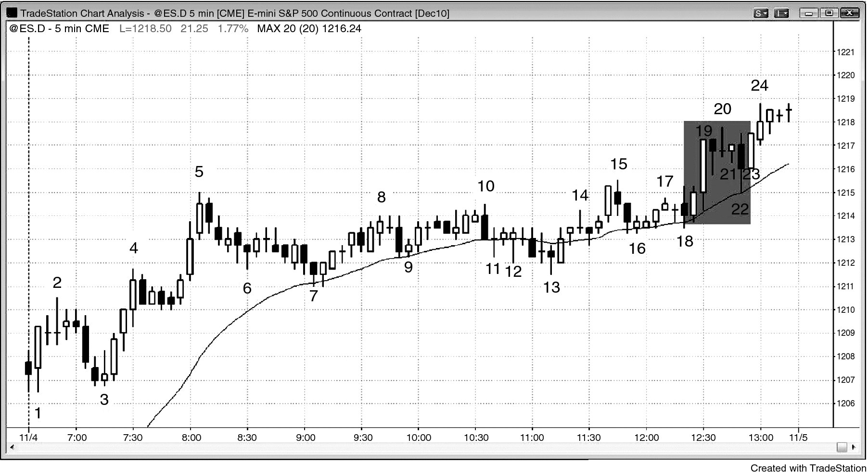
FIGURE 11.2 Trends into the Close Can Be Scary

Slide 3
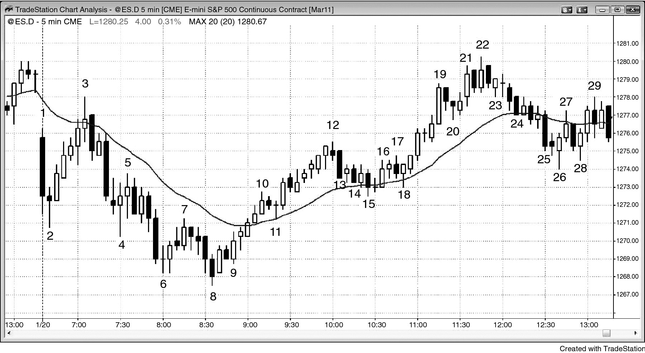
FIGURE 11.3 Midday Reversal

